Slide 1
Create deployment for Redis
First Create a redis-deploy.yml and create below code.
Then create Create a service.yml
apiVersion: apps/v1
kind: Deployment
metadata:
name: redis-deploy
labels:
app: redis
spec:
replicas: 1
selector:
matchLabels:
app: redis
template:
metadata:
name: redis
labels:
app: redis
spec:
containers:
- name: redis
image: redis:latest
ports:
- containerPort: 6379
apiVersion: v1
kind: Service
metadata:
name: redis
spec:
type: ClusterIP
ports:
- port: 6379
targetPort: 6379
selector:
app: redis

Slide 2
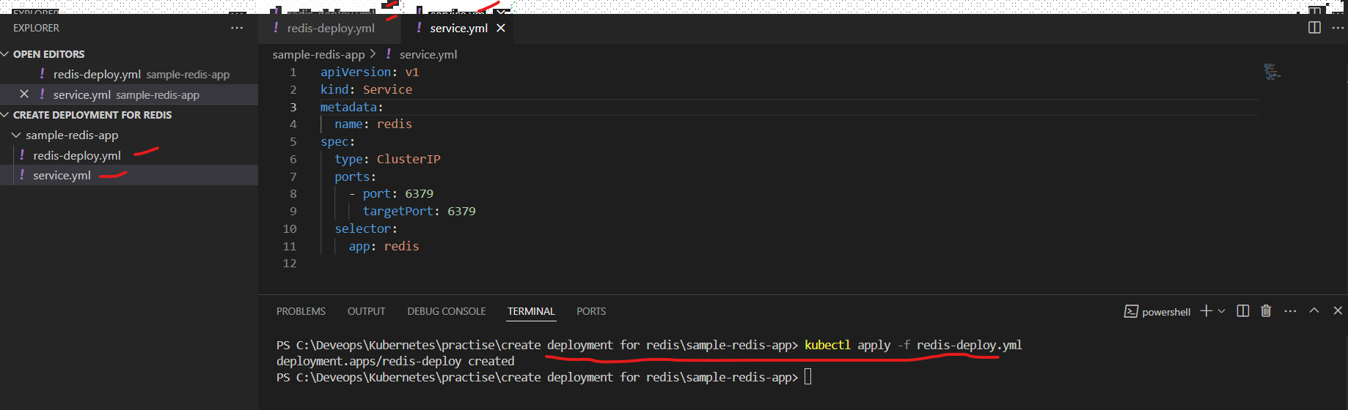
Apply command , the redis-deploy.yml

Slide 3
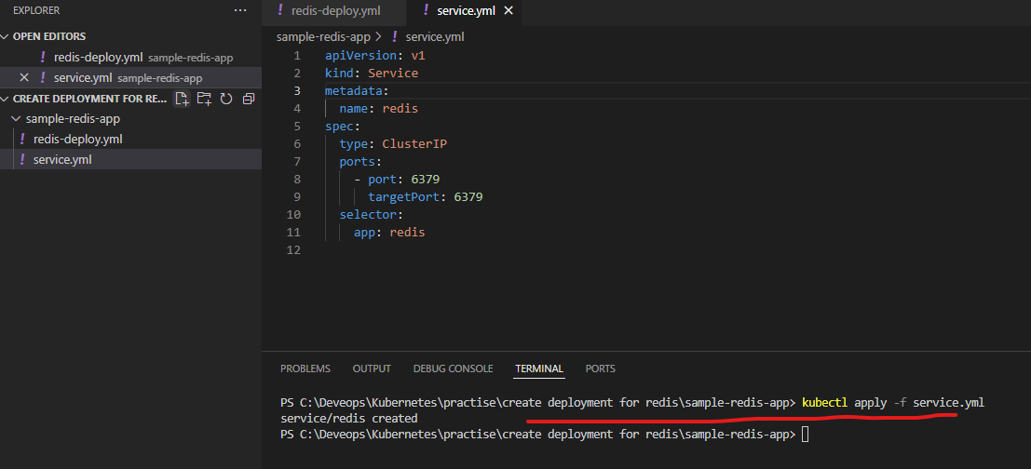
Apply command , the service.yml

Slide 4
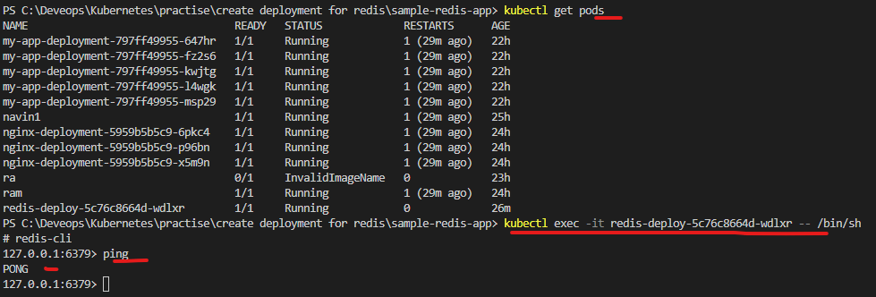
Check the output As below

